Slide 1
Binary Search

Slide 2
Motivation
1

Slide 3
Real Life Problem
Imagine you have a dictionary, and want to find some words in it. But you want to do this without going through the whole dictionary. So, what do you do?
How are you supposed to use a dictionary? Well, for those of you old enough to have used a real-world dictionary (not an online one), this will come easy: you open it right down in the middle, and check a random word from the page where you opened it. Now, if your word starts with the letter Q and the word you found in the middle starts with letter G, you know that the whole first half of the dictionary is useless to you right now, since the word is definitely in the second half. So you only need to search further in the second half.

Slide 4
Pick Number [ 1 , 1000]
And I will tell you the number in
10 Questions.

Slide 5
Abstract
2
Binary search is an efficient algorithm for finding an item from a sorted list of items.

Slide 6

How binary search works
1 | 3 | 5 | 7 | 11 | 13 | 17 | 19 | 23 | 29 | 31 | 37 | 41 | 43 | 47 | 53 | 59
3 | 5
7 | 11 | 13 | 17 | 19
23 | 29 | 31 | 37 | 41 | 43 | 47 | 53 | 59
1 | 2 | 3 | 4 | 5 | 6 | 7 | 8 | 9 | 10 | 11 | 12 | 13 | 14 | 15 | 16 | 17
1 | 2 | 3 | 4 | 5 | 6 | 7 | 8 | 9 | 10 | 11 | 12 | 13 | 14 | 15 | 16 | 17
1 | 2 | 3 | 4 | 5 | 6 | 7 | 8 | 9 | 10 | 11 | 12 | 13 | 14 | 15 | 16 | 17
1 | 2 | 3 | 4 | 5 | 6 | 7 | 8 | 9 | 10 | 11 | 12 | 13 | 14 | 15 | 16 | 17
Mid Right
Left Mid Right
Left Mid Right
Left Mid Right
$$O ( \log_{2}{(N) )}$$

Slide 7
Implementation
Int left = 0 , right = n – 1 ;
While ( left <= right )
{
int mid = ( left + right ) / 2 ;
if( arr [ mid ] == target ){
// x found at index mid
}
if(arr [ mid ] > target ){
right = mid – 1 ;
}
Else{
left = mid + 1 ;
}
}

Slide 8
Binary Searching on Monotonic Functions
3
Binary search is an efficient algorithm for finding an item from a sorted list of items.

Slide 9
Monotonic Function
Monotonic Function meaning that it is always non-decreasing or always non-increasing.
non-decreasing
non-increasing

Slide 10
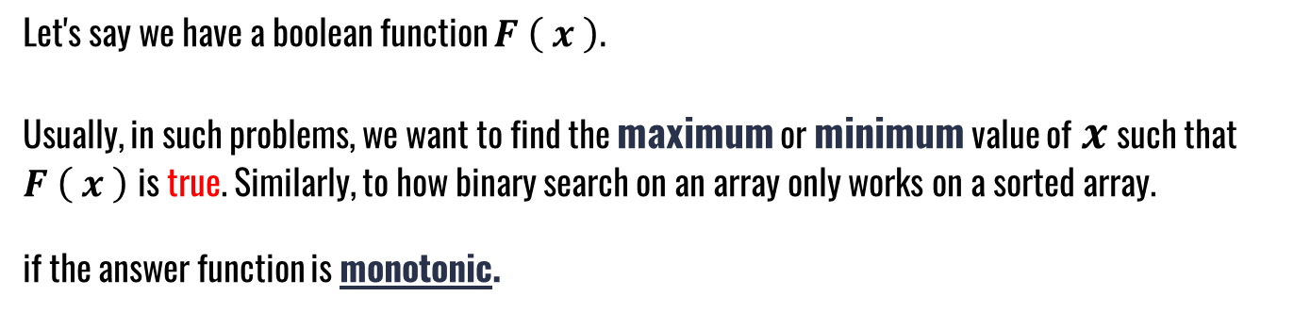
Definition
Let's say we have a boolean function $F \left( x \right).$
Usually, in such problems, we want to find the maximum or minimum value of $x$ such that $F \left( x \right)$ is true. Similarly, to how binary search on an array only works on a sorted array.
if the answer function is monotonic.

Slide 11
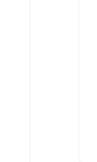

Example 1
Find first number greater than 5 in the following array
2 | 3 | 4 | 5 | 10 | 12 | 47 | 58 | 96 | 285
F | F | F | F | T | T | T | T | T | T
Left
Mid
Right
Mid
Right
$$Ans = 10$$

Slide 12
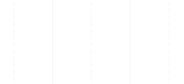
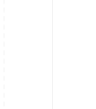


Example 2
Is 9 square number ? And find M when $($ $M^{2}=9 )$
1 | 2 | 3 | 4 | 5 | 6 | 7 | 8 | 9
1 | 4 | 9 | 16 | 25 | 36 | 49 | 64 | 81
Left
Mid
Right
Mid
Right
$$9=9$$
$$25 > 9$$

Slide 13
Problems
https://codeforces.com/contest/1201/problem/C
https://codeforces.com/contest/670/problem/D1
https://codeforces.com/contest/1476/problem/B
https://codeforces.com/contest/287/problem/B
https://www.codechef.com/problems/SQUIRREL
13

Slide 14
Library Functions For Binary Search
4
The CPP standard library contains some functions based on binary search

Slide 15
Lower Bound Scenarios
index | 0 | 1 | 2 | 3 | 4
value | 1 | 2 | 2 | 2 | 4
Search for 2
Return 1
index | 0 | 1 | 2 | 3 | 4
value | 1 | 5 | 6 | 7 | 7
Search for 9
Return 5
index | 0 | 1 | 2 | 3 | 4
value | 5 | 5 | 5 | 7 | 7
Search for 6
Return 3

Slide 16
Lower Bound
Returns an iterator pointing to the first element in the range [first,last[ which does not compare less than val.
Begin()
End()
Memory | 0ffx50 | 0ffx54 | 0ffx52 | 0fzx522 | 0ffo64 | 0ffxa5 | 0fyxa5
Value | 1 | 3 | 8 | 12 | 18 | 53
Int * index = lower_bound( First pointer , Last pointer , Value );

Slide 17
Lower Bound
Parameters
First : Start of search | Last : End of search | Value
We subtract First to get index of value
Return Value
An iterator to the lower bound of value in the range.
If all the element in the range compare less than value, the function returns Last.

Slide 18
Upper Bound Scenarios
index | 0 | 1 | 2 | 3 | 4
value | 1 | 2 | 2 | 2 | 4
Search for 2
Return 4
index | 0 | 1 | 2 | 3 | 4
value | 1 | 5 | 6 | 7 | 7
Search for 9
Return 5
index | 0 | 1 | 2 | 3 | 4
value | 5 | 5 | 5 | 7 | 7
Search for 6
Return 3

Slide 19
Upper Bound
Returns an iterator pointing to the first element in the range [first,last) which compares greater than val.
Begin()
End()
Memory | 0ffx50 | 0ffx54 | 0ffx52 | 0fzx522 | 0ffo64 | 0ffxa5 | 0fyxa5
Value | 1 | 3 | 8 | 12 | 18 | 53
Int * index = upper_bound( First pointer , Last pointer , Value );

Slide 20
Upper Bound
Parameters
First : Start of search | Last : End of search | Value
We subtract First to get index of value
Return Value
An iterator to the Upper bound of value in the range.
If no element in the range compares greater than value, the function returns last.

Slide 21
Problems
https://codeforces.com/problemset/problem/600/B
https://codeforces.com/contest/978/problem/C
https://codeforces.com/contest/1324/problem/D
https://atcoder.jp/contests/abc124/tasks/abc124_d
https://codeforces.com/contest/978/problem/F
21

Slide 22
THANKS!
Any questions?

